Slide 1
Genome Update
Shannon EK Joslin
GVL Lab Meeting
03 March 2021

Slide 2
outline
sequencing technologies
pipeline
current status
future use
genome
pipeline

Slide 3
terms
N50 – the LENGTH of contigs/scaffolds that contain 50% or more of the assembly
L50 – the NUMBER of contigs/scaffolds that contain 50% or more of the assembly
length = 20
length = 15
length = 10
…
N50 = 10
L50 = 3

Slide 4
terms
contig – a continuous stretch of DNA sequence created from a consensus of reads
scaffold – a string of DNA sequences with potential gaps created from chaining contigs together. Created by using sequence data and relative position and orientation data.
Gaps are denoted by the letter N
ATCGATCGTAATGGCTAGTGTGCAGCTAGTCATATATCGTA
ATCGATCGTAATGGCTAGTGTGCAGCTAGTCATATATCGTANNNNNNNNNNNNNNNGGCTAGTGTGCAGCTAGTCAT

Slide 5
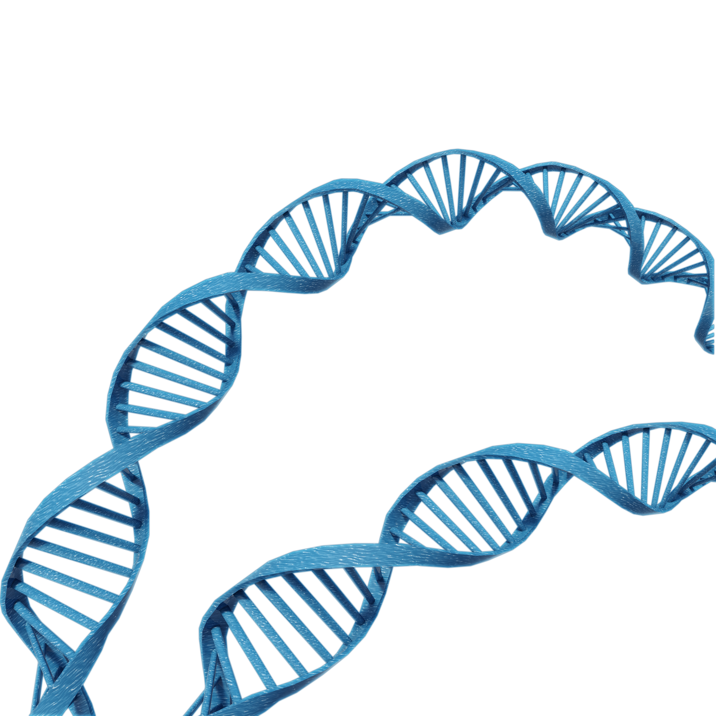
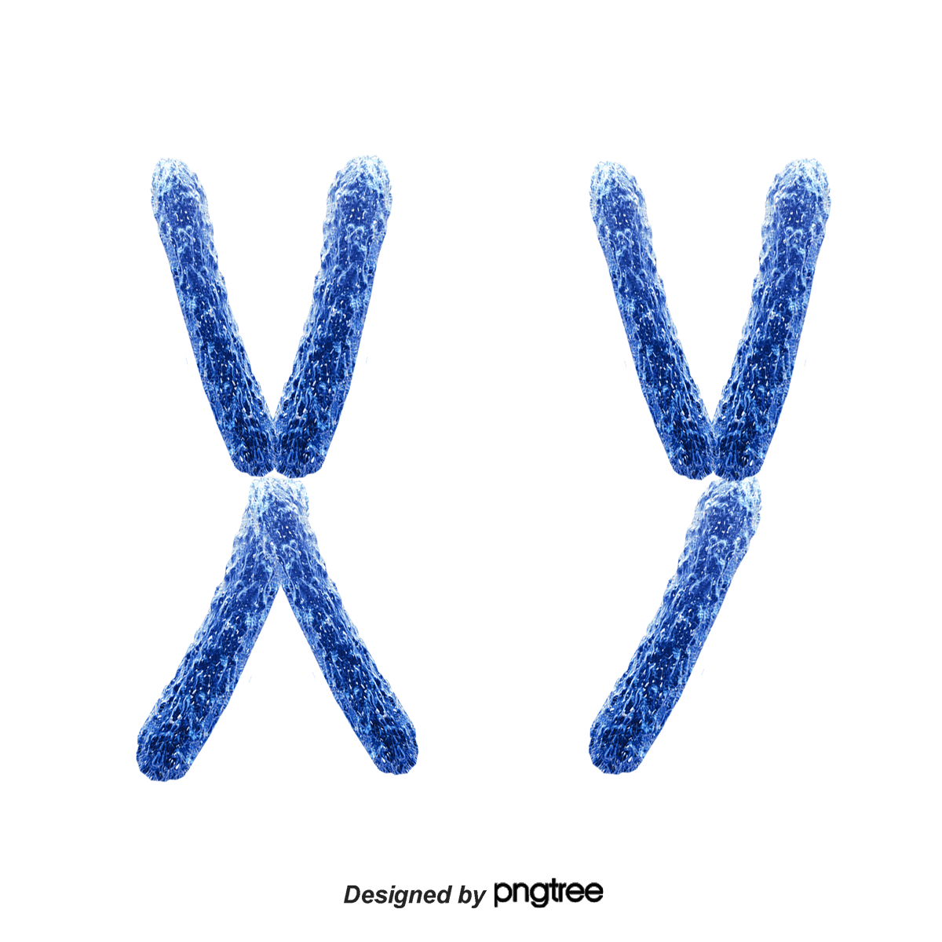
hybrid assembly
uses multiple sequencing technologies
each technology captures sequence data in different ways
long reads
hi-c
A
T
T
C
G
T
C
G
A
C
C
G
G
T
A
A
C
G
A
A
linked reads
Notes:
Now that we know the number of chromosomes we need to assemble let talk about how to do that. The best way to obtain a high quality assembly is by using multiple types of sequencing technologies. These technologies diversify how and what sequences you can capture and assemble. Long reads will span a relatively long distance, so they may capture entire chapters in a volume. However, they are quite error prone so one in every twenty words may be wrong. Linked reads are shorter and more accurate, so they will give you a series of sentences and say the sentences all come from a particular chapter. We can use these reads to correct the errors in the long reads. Hi-c will tell you where the chapter lie in relation to one another. For example, if you think about the example of an encyclopedia hi-c would tell you that the B section is always surrounded by the A section and the C section.

Slide 6
workflow #1
linked reads + hi-c
Sequencing
Initial Assembly
Sequencing
Scaffolding
…
Sample
HMW gDNA extraction
Linked-Read
(10X)
Genome!
Supernova
Hi-C
Lachesis
+
+
assembly metrics
assembly metrics

Slide 7
workflow #1
poor assembly metrics
Sequencing
Initial Assembly
Sequencing
Scaffolding
…
Sample
HMW gDNA extraction
Linked-Read
(10X)
Genome!
Supernova
Hi-C
Lachesis
+
+
assembly metrics
assembly metrics
N50 | 20,890
L50 | 205
n_contigs | 22,296
asm_length | 399,480,000

Slide 8
workflow #2
add in long reads
Sequencing
Initial Assembly
Add in sequencing technology
More sequencing
Scaffold
Scaffold
Sample
HMW gDNA extraction
Genome!
Long Reads
(PacBio)
FALCON
10X
scaff10x
Phase
SALSA
+
+
+
assembly metrics
assembly metrics
assembly metrics

Slide 9
workflow #2
couldn’t get FALCON to reliably run on the farm
Sequencing
Initial Assembly
Add in sequencing technology
More sequencing
Scaffold
Scaffold
Sample
HMW gDNA extraction
Genome!
Long Reads
(PacBio)
FALCON
10X
scaff10x
Phase
SALSA
+
+
+
assembly metrics
assembly metrics
assembly metrics

Slide 10
workflow #2
assembly metrics were trash
Sequencing
Initial Assembly
Add in sequencing technology
More sequencing
Scaffold
Scaffold
Sample
HMW gDNA extraction
Genome!
Long Reads
(PacBio)
canu + purge_dups
10X
scaff10x
Phase
SALSA
+
+
+
assembly metrics
assembly metrics
assembly metrics
previous
N50 | 20,890
L50 | 205
n_contigs | 22,296
asm_length | 399,480,000
N50 | 189,094
L50 | 474
n_scaffolds | 5276
asm_length | 487,140,827
N50 | 221,328
L50 | 427
n_scaffolds | 5055
asm_length | 487,157,651
N50 | 2,362,502
L50 | 50
n_scaffolds | 1641
asm_length | 488,874,151

Slide 11
workflow #2
a new long read assembler came out
Sequencing
Initial Assembly
Add in sequencing technology
More sequencing
Scaffold
Scaffold
Sample
HMW gDNA extraction
Genome!
Long Reads
(PacBio)
?
ipa
10X
scaff10x
Phase
SALSA
+
+
+
assembly metrics
assembly metrics
assembly metrics

Slide 12
workflow #2
a new long read assembler just came out
Sequencing
Initial Assembly
Add in sequencing technology
More sequencing
Scaffold
Scaffold
Sample
HMW gDNA extraction
Genome!
Long Reads
(PacBio)
?
ipa
10X
scaff10x
Phase
SALSA
+
+
+
assembly metrics
assembly metrics
assembly metrics
N50 | 418,614
L50 | 264
n_scaffolds | 1805
asm_length | 436,920,153
N50 | 1,392,224
L50 | 80
n_scaffolds | 1012
asm_length | 436,999,453
N50 | 4,383,157
L50 | 26
n_scaffolds | 515
asm_length | 437,264,453

Slide 13
workflow #2
incorporated linkage map data to close gaps
assembly metrics
Sequencing
Initial Assembly
Add in sequencing technology
+
Scaffold
More sequencing
Scaffold
Linkage Map
Sample
HMW gDNA extraction
Long Reads
(PacBio)
ipa
10X
scaff10x
Phase
SALSA
chromonomer
+
+
+
assembly metrics
assembly metrics
assembly metrics
Genome
?

Slide 14
workflow #2
success!
Sequencing
Initial Assembly
Add in sequencing technology
More sequencing
Scaffold
Scaffold
Linkage Map
Sample
HMW gDNA extraction
Long Reads
(PacBio)
ipa
10X
scaff10x
Phase
SALSA
chromonomer
final assembly stats
N50 | 14,850,352
L50 | 13
n_contigs | 376
asm_length | 437,273,953
Genome
!

Slide 15
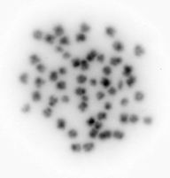
karyotyping experiment
in collaboration with Dr Mary Delaney’s lab
found 2n = 56
image is too low res to say anything about sex chromosomes or chromosome composition

Slide 16

are these assembly metrics good?
estimated genome size 465,000,000 (465Mb)
2n = 56 chromosomes (n = 28)
$$\frac{465,000 Kb}{28 chromosomes}≈16,000 {Kb}/{chromosome}$$
So a “perfect” assembly, not accounting for chromosome size variation would have the following stats:
“perfect” stats
final assembly stats
N50 | 16,000,000
L50 | 14
n_contigs | 28
asm_length | 465,00,000
N50 | 14,850,352
L50 | 13
n_contigs | 376
asm_length | 437,273,953

Slide 17
most of the contigs are small…
assembly read lengths
contig

Slide 18
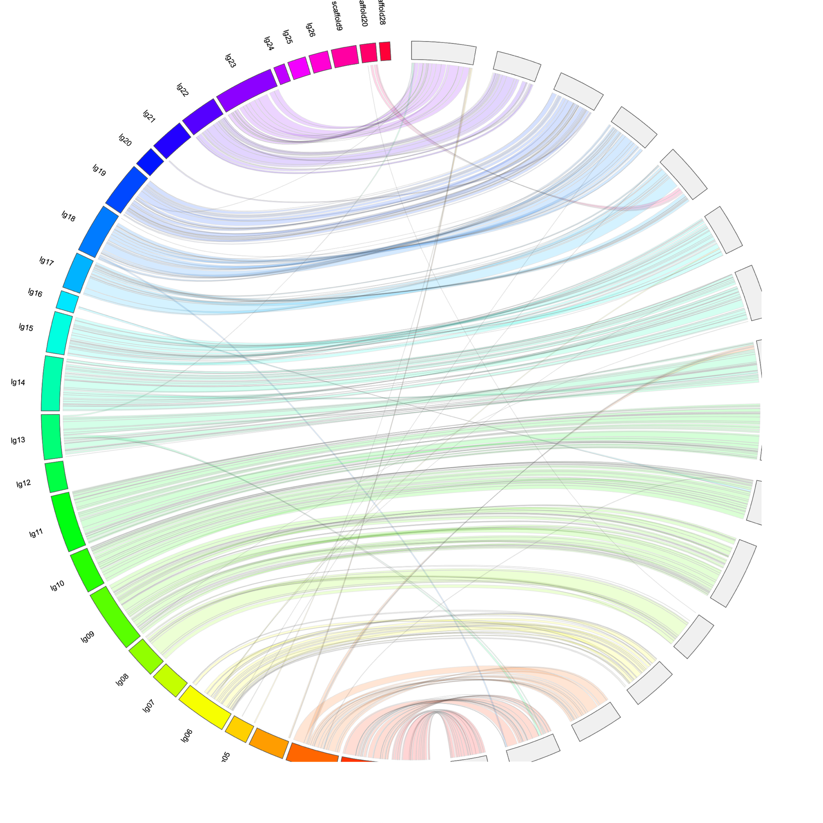
future work
MALE
FEMALE
need to resolve some placements
looking pretty good

Slide 19
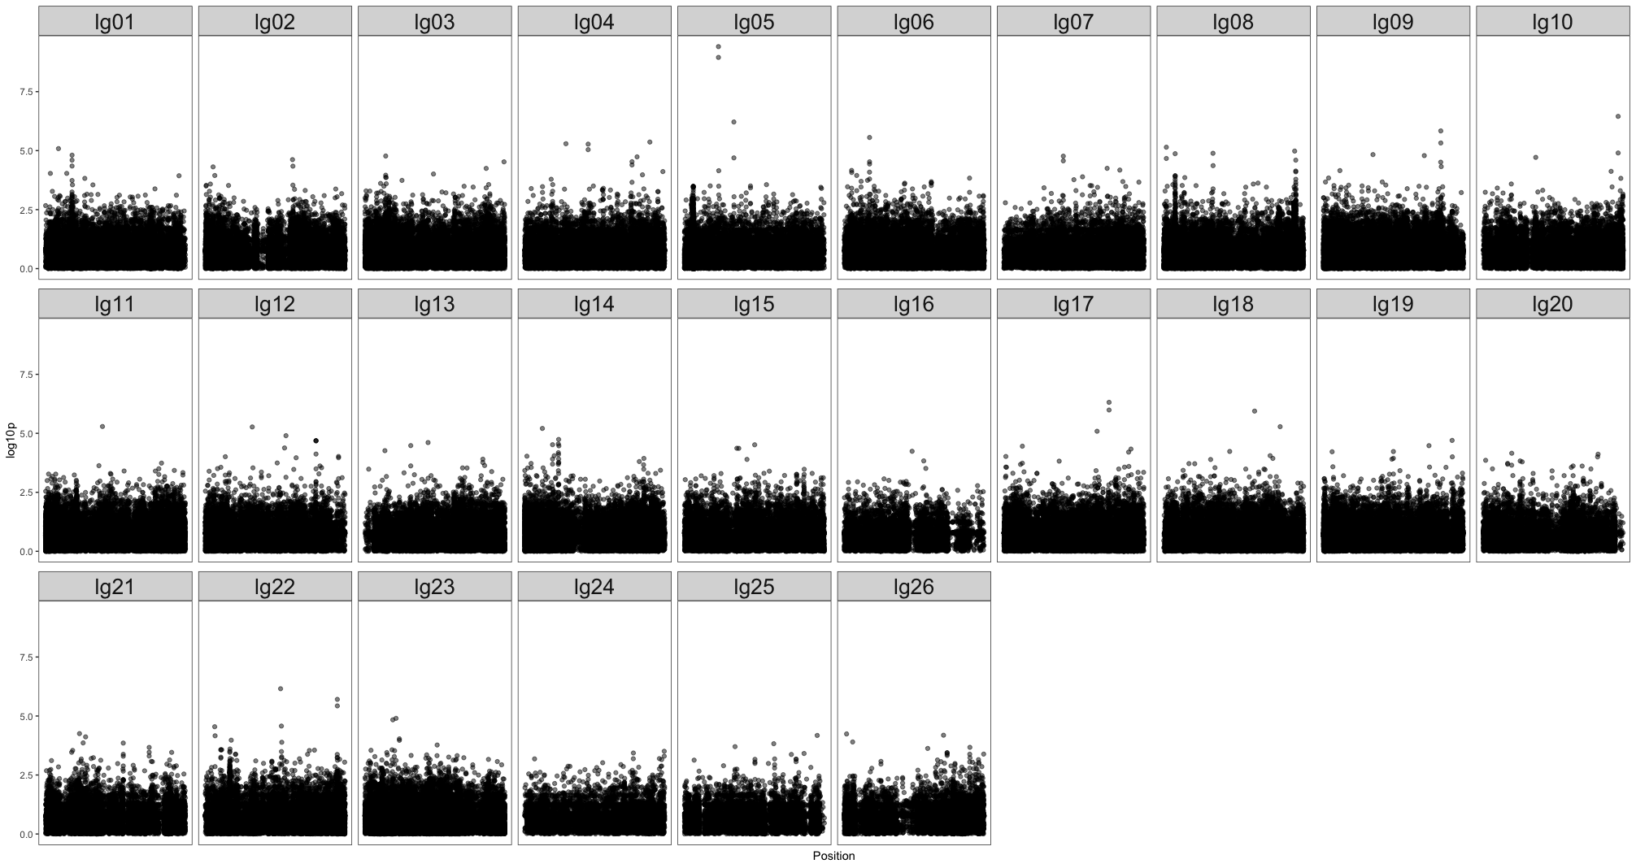
already used it for a GWAS

Slide 20
future
genome will be used by planned and ongoing delta smelt studies
assembly pipeline will be used for future assemblies

Slide 21
questions?

